Slide 1
Basic Statistics

Slide 2
Types of Statistics
Parametric versus Non-parametric
Descriptives versus Inferentials

Slide 3
Parametric v Not
Parametric – used on interval and ratio DV data, numbers that are continuous in nature
Requires more assumptions
Most of the stats we will use (ANOVA, regression)
Non-parametric – used on all data types (especially nominal, categorical)
Does not require same assumptions
Chi-square, log regression

Slide 4
Descriptives
Descriptive Statistics: create a picture of the data – describe
Mean – average of all scores
Variance – average distance of scores from the mean

Slide 5
Descriptives
Standard deviation – standardized variance (or standard average distance from the mean)
Standard error – standardized standard deviation (the estimate of SD for the population = SD / square root (N)).

Slide 6
Descriptives
Histograms and Frequency Tables
Frequency table show each individual data point, and the frequency of each of those points
Histogram is a graphical display of a frequency table
Shows you the distribution of the data

Slide 7
Distributions
Distribution descriptors: Unimodal, bimodal, multimodal, rectangular – describes the number of “humps” the distribution has.
Normal distributions – centered at the mean, unimodal, symmetric

Slide 8
Distributions
Skew – how “not normal” a distribution is (how much it leans).
Negative skew: scores are on the top (right side) of the distribution, tail is on the left side, sometimes called a ceiling effect.
Positive skew: scores are on the bottom (left side) of the distribution, tail is on the right side, sometimes called a floor effect.

Slide 9
Distributions
Kurtosis – how different from normal in shape a distribution is (skinnier, flatter).

Slide 10
How-To R
Frequency table
Histogram
Mean
Var/SD/SE
Skew/Kurtosis

Slide 11
How-To R
Frequency tables
table(column name)

Slide 12
How-To R
Histograms
hist(column name, binwidth = #)

Slide 13
How-To R
Mean
summary(dataframe name)
mean(column name, na.rm=T)

Slide 14
How-To R
Var/SD/SE
var(column name, na.rm = T)
sd(column name, na.rm = T)
se = sd / sqrt(N)
How do I get N?
length(column name)
So you can do sd(column name, na.rm = T) / sqrt(length(column name))

Slide 15
How-To R
Skew/Kurtosis
Install the moments package
Load the moments library
skewness(dataframe or column name, na.rm = T)
kurtosis(dataframe or column name, na.rm = T)

Slide 16
Inferentials
Infer information about the data.
Tells you if your data is different from some known sample OR some other data set.
Used for hypothesis testing.

Slide 17
Hypothesis Testing
Basic gist: You are pitting two rival answers against each other. Think of it like your favorite sport. You have a Favorite team (Research hypothesis) versus your enemy team (Null hypothesis). You want them to be different. You want your team to win (reject the null!).

Slide 18
Hypothesis Testing
Null hypothesis: You expect to find: 1) no difference between group scores (t-tests, ANOVA families), 2) no relationship between variables (regression families, Chi-square).

Slide 19
Hypothesis Testing
Research/alternative hypothesis: You expect to find: 1) differences in group scores, 2) relationships between variables.
Hypothesis testing = rock’em sock’em robots of statistics.
Why is this called Null Hypothesis Significance Testing (NHST)?

Slide 20
Hypothesis Testing
How do you determine which robot won?
p-values (most common)
Cut off scores (p-values friendly cousin)
Fit indices (EFA)

Slide 21
Hypothesis Testing
Rejecting the null / statistically significant – when your team wins! You find that the probability of the null hypothesis is very low, so you reject the idea that everything is equal (or that your team would never win).

Slide 22
Hypothesis Testing
Retaining the null / not statistically significant – the probability of the null hypothesis is not low enough, it could be that the groups are equal, or that your team might not win.

Slide 23
Terminology
P-values – the probability of getting that results (t-value, f-value, chi-square, etc.) if the NULL were true
You want your team to win! So you want the null to be false. Therefore, you want the probability of being wrong to be very low.

Slide 24
Terminology
Alpha – the probability of a Type 1 error (please note that alpha / = pvalue … you SET alpha as a criterion for a low type 1 error, which generally is p<.05, or p<.01, but it’s not the same thing as the p-actual found in your experiment).

Slide 25
Terminology
Alpha is also known as:
Type 1 error – rejecting the null hypothesis when it is FALSE.
Memory mnemonic: First mistake = worst mistake. Saying something happened when it did not.

Slide 26
Terminology
Beta – the probability of a Type 2 error, the opposite of power.
Type 2 error – failing reject the null hypothesis when you should reject the null (aka your research hypothesis is supported but you missed it…bummer).

Slide 27
Terminology
Power – the probability of rejecting the null when you should reject the null (aka your research hypothesis is supported and you showed that … yeah!).
G*Power is fantastical!
Power is normally used for sample size calculation, to determine how many participants you need to find statistical significance, given a set effect size and analysis type.

Slide 28
Terminology
Assumptions: Things that must be true for your test to return an answer that is reasonably correct
Therefore, when the assumptions are not met, you do not know what the answer you got actually means.

Slide 29
Effect Size
Effect size is a measure of “how big” an effect was in your experiment. For example, you might reject the null hypothesis (yay the experiment worked!), but then determine that the group differences or relationships were small (boo).
Effect size is considered “a measure of strength of a phenomenon” for a technical definition.

Slide 30
Effect Sizes
Those based on mean differences (Used for: any time you have two means: t-tests, ANOVA post hoc tests)
Cohen’s d - Cohen’s d is one of the most well-known calculations for effect size. The general formula gives the standardized distance between the two population means, or how much the two populations do not overlap. The formula for d is very adaptive and can be used for many different between samples and within samples tests.
Some others based on this idea: Hedges’ g and Glass’ delta.

Slide 31
Effect Sizes
Size Guide Lines:
Small .2
Medium .5
Large .8
Can get very big or be negative.

Slide 32
Effect Sizes
Those based on variance overlap (Used for: ANOVA overalls, regression)
η ² (eta squared) and R² – These statistics are based on the amount of variance that you have accounted for by your manipulation (groups) or independent variable (like predictors in regression) out of the total variance.

Slide 33
Effect Sizes
ω² – omega squared is an estimate of the population effect size for eta and r squared (so it’s usually smaller than the other two) and is an evil disaster we are going to avoid.
Eta squared is the most common for ANOVA, R² is more common for regression.
Why?! Beats me…they are the same thing.

Slide 34
Effect Sizes
There are also partial versions of all three of these statistics for when you have more than one IV … that means that you can calculate the effect size of each piece separately, rather than the experiment as a whole (useful to know which variable was the “best”).

Slide 35
Effect Sizes
Sizes (the rules for this are not as set in stone as the d):
Small .01
Medium .09
Large .25
Since this statistic is the proportion of variance over a total, it ranges from 0 to 1 and cannot be negative.

Slide 36
Effect Sizes
For categorical variables:
Odds-ratios – gives you the odds of one group membership over another.
φ and Cramer’s V – chi-square statistic (for independence tests only, see below) that is loosely based on Cohen’s d.

Slide 37
Basic Statistics Review
t-Tests
Single
Dependent
Independent
Correlation
Chi-square

Slide 38
t-Tests
Types
Single sample – one group of people, a population mean, NO population standard deviation.
Dependent – one group of people tested twice!
Independent – two groups of people.

Slide 39
t-Tests
Assumptions:
Normal Curves
Homogeneity – equal variances for each group
Linearity – the DV is linear for the relationship between IV groups

Slide 40
t-Tests
Single sample example:
Uses: when you have one group of people to compare to a population mean.
A school has a gifted/honors program that they claim is significantly better than others in the country. The national average for gifted programs is a SAT score of 1250.
Use the file single sample t-test here.

Slide 41
t-Tests
Single how-to:
First import the data.
Import dataset > from text file
Call it singlet
t.test(column name, mu = #)
MU = the population mean

Slide 42
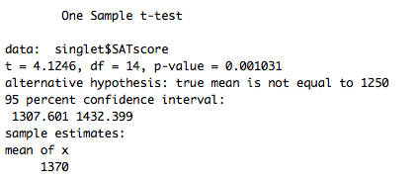
t-Tests

Slide 43
MOTE! Effect Size
Download MOTE from online.
Let’s do the MOTE thing.

Slide 44
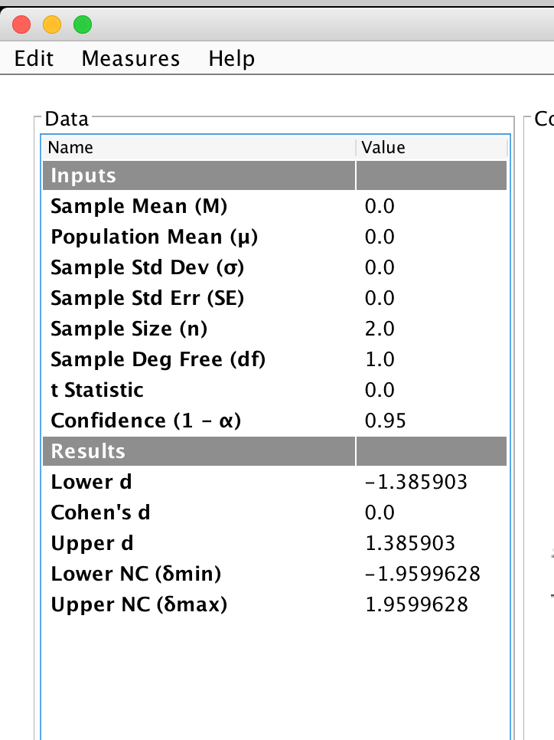
Single Sample t
Mean
Population mean
SD
N

Slide 45
t-Tests
Write up example:
M = 1370.00, SD = 112.68, t(14) = 4.13, p = .001, d = 1.06

Slide 46
t-Tests
Dependent t-test example:
Use: when you have one group of people tested twice, before/after scores, etc.

Slide 47
t-Tests
Example: In a study to test the effects of science fiction movies on people's belief in the supernatural, seven people completed a measure of belief in the supernatural before and after watching a popular science fiction movie. Participants' scores are listed below with high scores indicating high levels of belief. Carry out a t test for dependent means to test the experimenter's assumption that the participants would be less likely to believe in the supernatural after watching the movie.

Slide 48
t-Tests
Dependent t how-to:
Import the dataset.
Call it dependentt.
Look out it imported. DOH.
Melt the data!

Slide 49
t-Tests
Melt the data!
Install the reshape package.
Load the reshape library.
melt(dataset name,
id = c(variables that don’t change),
measured = c(variables that do change))

Slide 50
t-Tests
Now we can work with the data in long format.
t.test(DV name ~ IV name, paired = TRUE)

Slide 51
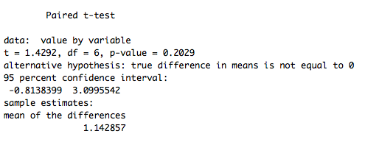
t-Tests

Slide 52
t-Tests
tapply() – table-apply allows you to calculate means, sd, whatever with categorical variables
tapply(DV name, list(IV names), function)

Slide 53
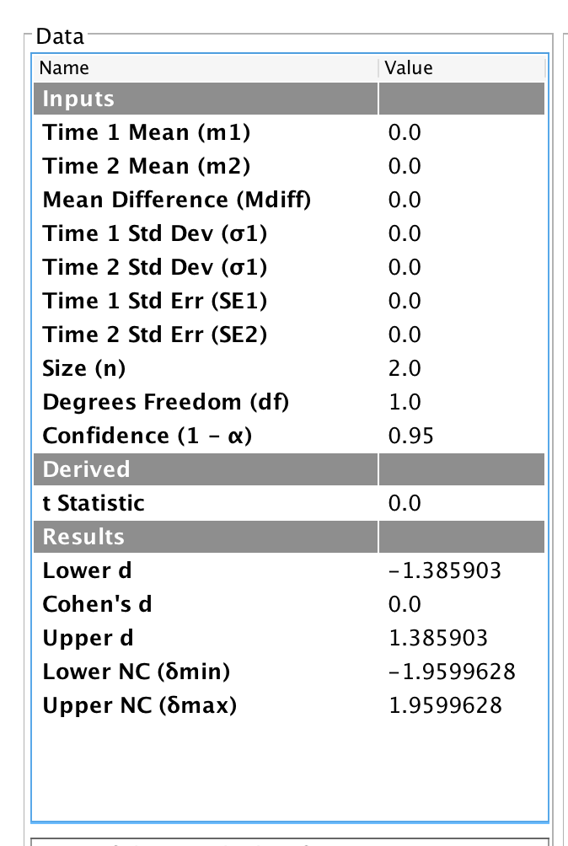
Dependent t averages:
Time 1
Time 2
SD time 1
SD time 2
N

Slide 54
t-Tests
How to write:
Mdiff = -1.14, SDdiff = 2.12
Before M = 5.57, SD = 1.99
After M = 4.43, SD = 2.88
t(6) = 1.43, p = .20, d = 0.54

Slide 55
t-Tests
Independent t-test example:
Use: Two groups (only two, no more) of completely separate people.

Slide 56
t-Tests
Example: A forensic psychologist conducted a study to examine whether being hypnotized during recall affects how well a witness can remember facts about an event. Eight participants watched a short film of a mock robbery, after which each participant was questioned about what he or she had seen. The four participants in the experimental group were questioned while they were hypnotized and gave 14, 22, 18, and 17 accurate responses. The four participants in the control group gave 20, 25, 24, and 23 accurate responses. Using the .05 significance level, do hypnotized witnesses perform differently than witnesses who are not hypnotized?

Slide 57
t-Tests
Independent t how-to:
Import the dataset
Call it indt
t.test(DV name ~ IV name,
raired = F,
var.equal = T)

Slide 58
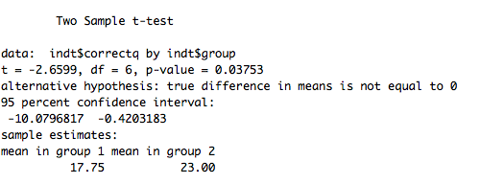
t-Test

Slide 59
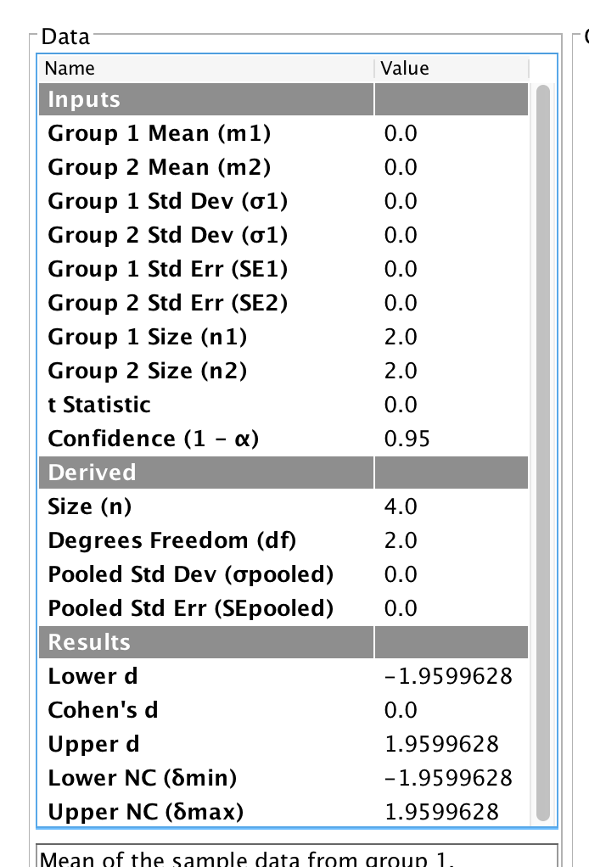
Independent t-test
Mean 1
Mean 2
SD 1
SD 2
N 1
N 2

Slide 60
t-Tests
Write up:
Experimental group M = 17.75, SD = 3.30
Control group M = 23.00, SD = 2.16
t(6) = -2.66, p = .04, d = 1.09

Slide 61
Correlation
Uses: when you have two variables, but do not know which one caused the other one. You should be using at least mildly continuous variables.

Slide 62
Correlation
Assumptions
Normality
Homogeneity
Homoscedasticity – the spread of the errors for the X variable is the same all the way across the Y variable (equal errors)
Linearity

Slide 63
Correlation
Example: Scores were measured for femininity and sympathy. Is there a correlation between those two variables?

Slide 64
Correlation
How-to:
Install the Hmisc package (may be already installed)
Load the Hmisc library
Import the dataset
Call it correldata
rcorr(as.matrix(dataset))

Slide 65
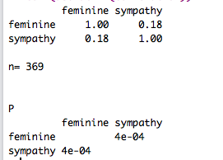
Correlation

Slide 66
Correlation
Write: r = .18, p < .001.

Slide 67
Chi-Square
Chi-square is a non-parametric test – meaning that you do not need the normal parametric assumptions.
Assumptions:
Each person can only go into one category.
You need enough people in each category (no small frequencies or small expected frequencies).

Slide 68
Chi-Square
Uses: when you have nominal (discrete) data and want to understand if the categories are equal in frequency.
Types:
Goodness of fit – one variable
Independence – two variables
Multiway frequency analysis – three or more variables

Slide 69
Chi-Square
Example: The included data shows results of a survey conducted at a particular high school in which students who had a small, average, or large number of friends were asked whether they planned to have children.
Independence test

Slide 70

Chi-Square
How-to:
Load the data
Call it chisqdata
chisq.test(column name, column name)

Slide 71

Chi-Square
Write: X²(4) = 2.05, p = .73, V = .13.
X² is the chi-square value
N = total number of participants
k = the smaller number of rows or columns
If you have 2 rows and 3 columns, that would be 2-1

